Slide 1
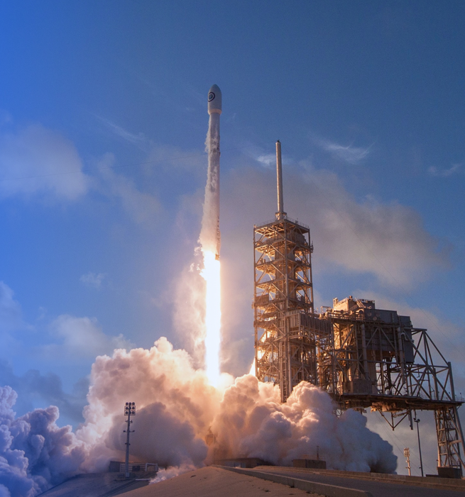

Data Science CapStone Project
Nithya Nalluri
4/30/2024

Slide 2

Outline
Executive Summary
Introduction
Methodology
Results
Conclusion
Appendix

Slide 3

Executive Summary
Overview of all methodologies:
Data Collection
Data Wrangling
Exploratoring Data Analysis
Intercative Visual Analysis
Preddictive Analysis
Overview of all results:
Exploratory Data Analysis Results (EDA)
Geospatial Analytics
Interactive dashboard
Predicitive anaylsis of classfiction modes

Slide 4

Introduction
Project Background:
SpaceX has launched Falcon rockets at the cost of roughly $62 million. Overall compared other companys thheir luanch was siginatly cheaper as some of their luanchs can be upwards of $165 million. Spacex is able to reduce the cost of their launchs by being able to reuse tier first stage of the rocket
Project Goal:
If We prediction if launchs will be able to land or not in their first stages, and determine the cost of the launch. Using this information can use when a company wants to bid aganist spacex for a rocket launch
Project Result:
This project will allow us to predict to perdict if spacex falcon 9 will land sucessfully

Slide 5

METHODOLOGY SUMMARY
1) Data Collection
Sending GET request to SPACEX REST API and creating new dataframe
Web scraping
2) Data Wrangling
Remove all NaN values
Count number of istnaces for the follow questions
Add Labels to landing outcomes
0 if bosster does not land sucessfully
1 if booster does land sucessfully
3) Explortatory Data Analysis
Using Matplotlib and Seaborn to create visualtin that shjow realstionships between differet variables and find any trends of pattersn in the plots
Used SQL to query through the SPACEX to find certain data
5

Slide 6
METHODOLOGY SUMMARY (cont.)
4) Interactive Visual Analytics
Using Folium to do Geospatial analysis
Creating interactive maps
Displaying data overlaying maps
Using Plotly Dash to create a interactive dashboard
Supports various types of charts and allows for zomming, panning and annotation on the plots
5) Data Modeling and Evaluation
Using Scikit-learn to do the following:
Prepocessing
Train-Test Splits
Classification Models
Hyperparameter Tuning with GridSearchCV
Create Confusion Matrices
Assessing Accuracy
6

Slide 7
Data Collection
1) Requesting all the contents of the SPACEX API and convert into dataframe
1) Extract a Falcon 9 launch records from HTML page
2) Reconstructing the dataset into a dictionary format and then into a DataFrame using helper functions
SPACEX REST API
Web Scraping
2) Parse the launch HTML table and convert it into a dataframe
3) Filtering dataframe to only include Falcon 9 launch data and remove missing values
7
GitHub Link

Slide 8
Data Collection (SPACEX REST API)
1) Requesting all the contents of the SPACEX API and convert into dataframe
Step 1: Sending GET requests to the SPACEX REST API and return the GET response
Step 2: Convert the response to .json then to pandas dataframe
GitHub Link
# Spacex Rest API link
space_url = “https://...”
# Sending a GET request to the Spacex Rest API
response = requests.get(spacex_url)
# If status response is 200, request of successfull
response.status_code
# .json() to turn response into JSON format
r = response.json()
#n.json_normalize() turns the .json to the Pandas dataframe
data = pd.json_normlize(r)
8

Slide 9
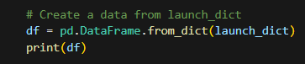
Data Collection (SPACEX REST API) Cont.
2) Reconstructing the dataset into a dictionary format and then into a dataframe using helper functions
Step 1: Creating global variables for all the column headers to store data returned by the helper functions
Step 2: Utilizing the helper functions (getLaunchSite, getBoosterVersion, getPayloadData, getCoreData) to fetch data from columns with IDs
Step 3: Merging the columns into a dictionary format using the received data and defined global variables
Step 4: Creating a dataframe from the launch_dict dictionary
launch_dict = {'FlightNumber': list(data['flight_number']),
'Date': list(data['date']),
'BoosterVersion':BoosterVersion,
'PayloadMass':PayloadMass,
'Orbit':Orbit,
'LaunchSite':LaunchSite,
'Outcome':Outcome,
'Flights':Flights,
'GridFins':GridFins,
'Reused':Reused,
'Legs':Legs,
'LandingPad':LandingPad,
'Block':Block,
'ReusedCount':ReusedCount,
'Serial':Serial,
'Longitude': Longitude,
'Latitude': Latitude}
#Global variables
BoosterVersion = []
PayloadMass = []
Orbit = []
LaunchSite = []
Outcome = []
Flights = []
GridFins = []
Reused = []
Legs = []
LandingPad = []
Block = []
ReusedCount = []
Serial = []
Longitude = []
Latitude = []
# Call getLaunchSite
getLaunchSite(data)
# Call getBoosterVersion
getBoosterVersion(data)
# Call getPayload
getPayloadData(data)
# Call getCoreData
getCoreData(data)
Step 1
Step 2
Step 3
Step 4
9
GitHub Link

Slide 10
Data Collection (SPACEX REST API) Cont.
3) Filtering dataframe to only include Falcon 9 launch data and remove missing values
Step 1: Using the BoosterVersion cloumn to keep Falcon 9 launches
Step 2: Calculate the mean of PayloadMass using .mean() and using .replce() to replace any missing values (np.nan) in the data with the PayloadMass mean value
GitHub Link
Step 1
Step 2
data_falcon9 = df[df['BoosterVersion'] != 'Falcon 1']
print(data_falcon9)
# Count the number of null values in each column
null_counts = data_falcon9.isnull().sum()
# Calculate the mean value of PayloadMass column
payload_mass_mean = data_falcon9['PayloadMass'].mean()
# Replace the np.nan values with its mean value
data_falcon9['PayloadMass'].replace(np.nan, payload_mass_mean, inplace=True)
# Check the updated DataFrame
print(data_falcon9)
# Check for any remaining NaN values
print(data_falcon9.isnull().sum())
10

Slide 11
Data Collection (Web Scraping)
1) Extract a Falcon 9 launch records from HTML page
Step 1: Using HTTP GET method to request from URL Falcon 9 launch data
Step 2: Create BeautifulSoup object from HTML response
Step 3: Extract all the column header names from the HTML table
GitHub Link
Step 3
Step 1
# Use the find_all function in the BeautifulSoup object, with element type `table`
html_tables = soup.find_all('table’)
# Let's print the third table and check its content
first_launch_table = html_tables[2]
column_names = []
# Apply find_all() function with `th` element on first_launch_table
for r in first_launch_table.find_all('th'):
c_name = extract_column_from_header(r)
if (c_name != None and len(c_name) > 0):
column_names.append(c_name)
print(column_names)
# use requests.get() method with the provided static_url
r = requests.get(static_url)
# assign the response to a object
obj = r.text
Step 2
# Use BeautifulSoup() to create a BeautifulSoup object from a response text content
soup = BeautifulSoup(obj, 'html')
11

Slide 12
Data Collection (Web Scraping) cont.
2) Parse the launch HTML table and convert it into a dataframe
Step 1: Create empty dictionary with keys from the column names
Step 2: Parsing launch record values from the new dictionary
Step 3: Create dataframe
extracted_row = 0
#Extract each table
for table_number,table in enumerate(soup.find_all('table',"wikitable plainrowheaders collapsible")):
# get table row
for rows in table.find_all("tr"):
#check to see if first table heading is as number corresponding to launch a number
if rows.th:
if rows.th.string:
flight_number=rows.th.string.strip()
flag=flight_number.isdigit()
else:
flag=False
launch_dict= dict.fromkeys(column_names)
print(launch_dict)
# Remove an irrelvant column
del launch_dict['Date and time ( )']
# Let's initial the launch_dict with each value to be an empty list
launch_dict['Flight No.'] = []
launch_dict['Launch site'] = []
launch_dict['Payload'] = []
launch_dict['Payload mass'] = []
launch_dict['Orbit'] = []
launch_dict['Customer'] = []
launch_dict['Launch outcome'] = []
# Added some new columns
launch_dict['Version Booster']=[]
launch_dict['Booster landing']=[]
launch_dict['Date']=[]
launch_dict['Time']=[]
Step 1
Step 2
# Assuming launch_dict is a dictionary with keys as column names and values as lists
df = pd.DataFrame({key: pd.Series(value, dtype='object') for key, value in launch_dict.items()})
12
GitHub Link
Step 3

Slide 13
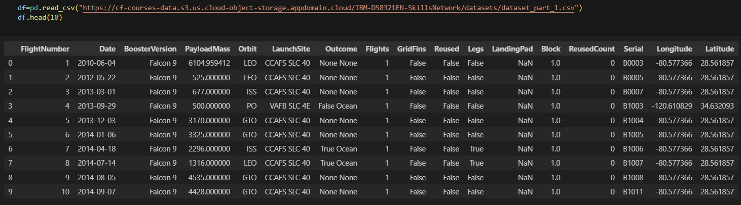
Data Wrangling
In the next slides the Logic and Code
GitHub Link
Define labels to the data for superviised model training
Loading in dataset into a dataframe
finding patterns in the data
Code

Slide 14
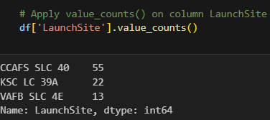
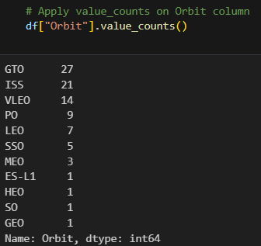
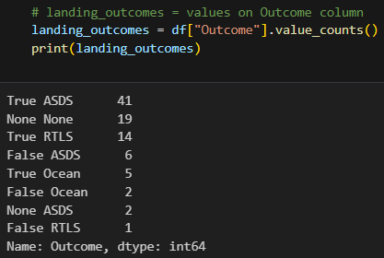
Data Wrangling (cont.)
1) finding patterns in the data
Task 1: Calculate the number of launches on each site
There are 3 launch sites
Task 2: Calculate the number and occurrences of each orbit
There are 11 different orbits
Task 3: Calculate the number and occurances of mission outcome of the orbits
There are 8 different landing outcomes
True ASDS: Successfully landed on a drone ship
False ASDS: Successfully landed on a drone shiip
None ASDS: Failed To Land
True RTLS: Unsuccessfully landed to a ground pad
False RTLS: Unsuccessfully landed to a ground pad
True Ocean: Successfully landed to a certain region in ocean
False Ocean: Unsuccessfully landed to a certain region in ocean
None None: Failed To Land
Task 1
Task 2
Task 3
GitHub Link

Slide 15
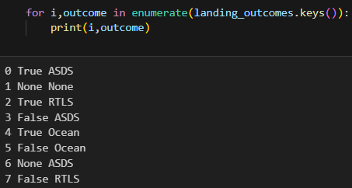
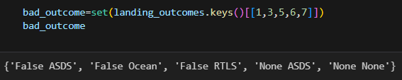
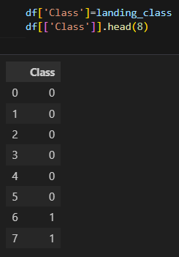
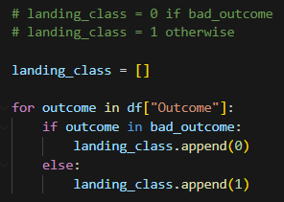
Data Wrangling
(cont.)
Step 1
Step 2
Using the number labels that correspond to the mission outcomes that did not successfully land and adding them all to a variable called `bad_outcome`
2) Define labels to the data for superviised model training
Convert the various mission outcomes into binary labels
1 for Successful landing
True ASDS: Successfully landed on a drone ship
True RTLS: Unsuccessfully landed to a ground pad
True Ocean: Successfully landed to a certain region in ocean
0 for Unsuccessful landing
False ASDS: Successfully landed on a drone shiip
None ASDS: Failed To Land
False RTLS: Unsuccessfully landed to a ground pad
False Ocean: Unsuccessfully landed to a certain region in ocean
None None: Failed To Land
Enumerating all the mission outcomes from 0 to 7 labels instead of using their string name as the key
Step 4
Step 3
Using the "Outcome" column to check if any values in the column equal values in the "bad_outcome" variable, then set them to 0; otherwise, set them to 1 into a list called "landing_class"
Output of a new column in the DataFrame called "Class" that stores the binary labels for the mission outcomes
GitHub Link

Slide 16
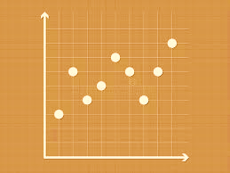
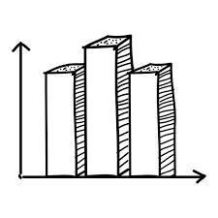
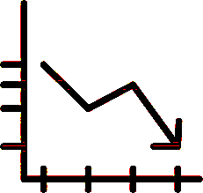
EDA with Data Visualization
Scatter Plot
1) Scatter Plot: Used to observe the relationship/correlation between two or more numeric variables
Relationship between Flight Number and Launch Site
Relationship between Payload and Launch Site
Relationship between Flight Number and Orbit Type
Relationship between Payload and Orbit Type
2) Bar Chart: Used to compare numerical values with categorical variables and observe the highest occurring groups compared to the other groups
Relationship between Success Rate of each Orbit Type
3) Line Chart: Used to show the change of a certain numerical variable over time
Relationship between Success Rate and Year
Bar Chart
Line Chart
GitHub Link

Slide 17
EDA with SQL
Using SQL queries and operations to better understand the SpaceX dataset:
Display the names of the unique launch sites in the space mission
2. Display 5 records where the launch begins with the string "CCA“
3. Display the total payload mass carried by boosters launched by NASA (CRS)
4. Display the average payload mass carried by booster version F9. v1.1
5. List the data when the first successful landing outcome on a ground pad was achieved
6. List the names of the boosters that had successfully landed on a drone ship with a payload mass between 4000 and 6000 kg
7. List the total number of successful and failed mission outcomes
8. List the names of the booster versions that have carried the maximum payload mass
9. List the failed landing outcomes on a drone ship, including their booster versions and launch site names for 2015.
10. Rank the count of landing outcomes between the dates 2010-06-04 and 2017-03-20 in descending order
Failure: drone ship
Success: ground pad
GitHub Link

Slide 18
Interactive Map with Folium
Using Folium interactive maps to help analyze the geospatial data to better visualize the location and proximity of the launch sites and how that might impact the launch success rate
Step 1: Mark all the launch sites
Initialize the map using a Folium Map object
Use `folium.Circle` and `folium.Marker` to highlight each launch site on the map with a circle
Step 2: Mark all the successful/failed launches from each site
Use `MarkerCluster()`
Green indicates a successful launch, and red indicates a failed launch
Step 3: Calculate the distances between the launch sites and their proximities using latitude and longitude values
For coastline, railroad, highway, and cities
First, use `MousePosition()` to help mark the latitude and longitude values
Create a marker using `folium.Marker()`
Draw using `folium.Polyline()`
Report the steps above for each proximity from launch sites using markers and drawing lines
Step 4: Answer the following questions
Are launch sites in close proximity to railways?
Yes
Are the launch sites in close proximity to highways?
Yes
Are the launch sites in close proximity to the coastline?
Yes
Do the launch sites keep a certain distance away from cities?
Yes
GitHub Link

Slide 19
Interactive Plotly Dashboard
Using Plotly API in Python to create an interactive dashboard consisting of a pie chart and a scatter plot
Pie Chart: Displays successful launches per site
Interaction Options:
Clicking on the dropdown menu for all sites shows the successful launches for all sites as a percentage in a pie chart.
Clicking on the dropdown menu for a specific launch site shows the success versus failed launches from that site as a percentage in the pie chart.
Scatter Plot: Shows the correlation between the outcome of launches and the payload mass
Interactive Filtering:
Use the filter to select the minimum and maximum range of the payload mass in kilograms.
GitHub Link

Slide 20
Predictive Analysis (Classification)
Below are the steps to create a model, evaluate the model, and find the most optimal classification model
Find Optimal Classification Model
Create Models
Evaluate Models
Steps:
Load the Dataset
2. Perform Data Standardization and Preprocessing
3. Split the Data
Training set
Testing set
4. Run Different Classification Algorithms with the Data
5. Create an object for each of those algorithms
Create a GridSearchCV object and pass the algorithm objects and the required hyperparameters
Steps:
GridSearchCV Outputs:
Best parameters: Hyperparameters
Best score: Accuracy on the validation data
Create Confusion Matrix
For each algorithm
Examine Confusion Matrix
For each algorithm
Steps:
Review the accuracy scores
For all classification algorithms
Find the highest accuracy
Will help identify the best performing model
GitHub Link

Slide 21

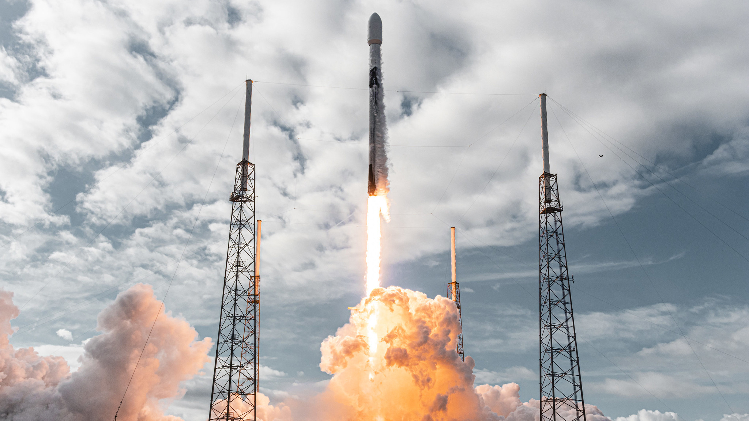
Results
Overview
Exploratory data analysis (EDA) results
Interactive analytics demo in screenshots
Predictive analysis results

Slide 22

EDA with Visualization

Slide 23
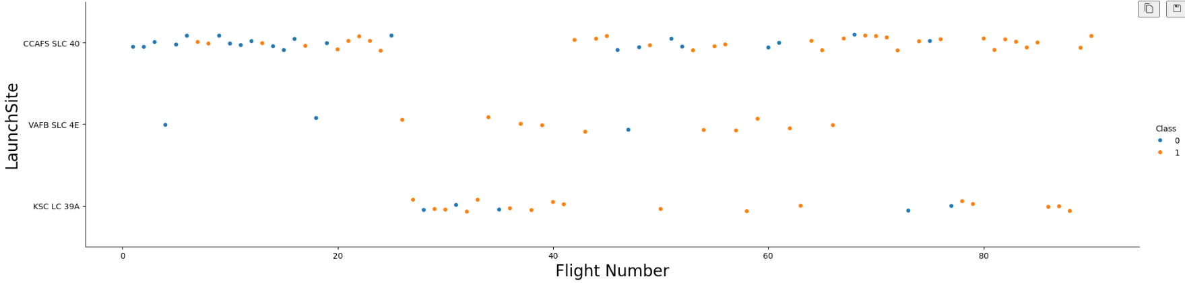
Flight Number vs. Launch Site
Output
The plot shows the relationship between the 3 launch sites on the y-axis and the flight number on the x-axis.
The classes 1 and 0 represent successful and failed missions, respectively.
The pattern we can observe is that earlier flight numbers, such as those from launch site CCAFS 5LC 40, had more failures initially, while later flight launches tend to be more successful. This trend is evident across the other launch sites as well.

Slide 24
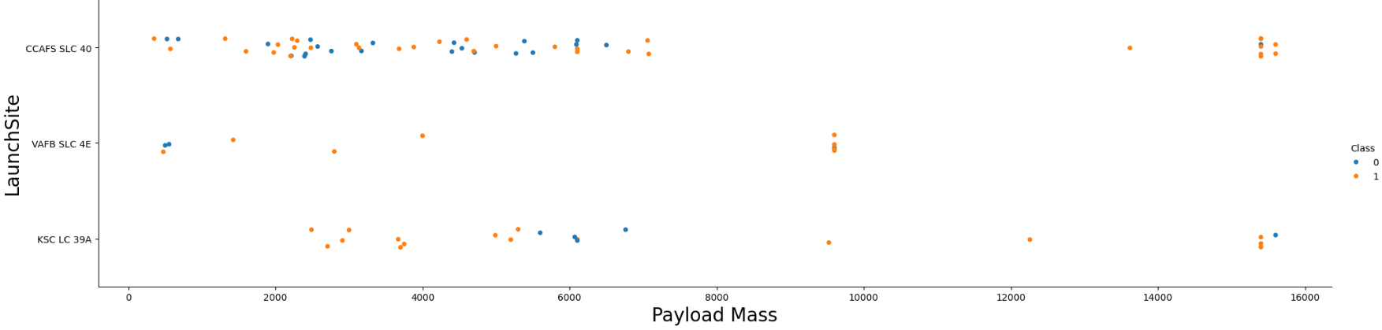
Payload vs. Launch Site
Output
The plot shows the relationship between the 3 launch sites on the y-axis and the payload mass on the x-axis.
The classes 1 and 0 represent successful and failed missions, respectively.
We can observe that the flights tend to have a payload mass between 0kg to 7500kg. There are very few flights with a payload mass between 9000kg to 16000kg. Interestingly, at this higher payload mass range, there were fewer failures in the flight launches.

Slide 25
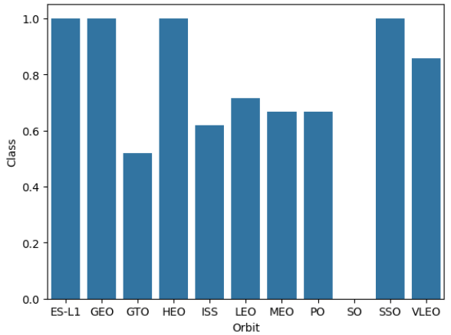
Success Rate vs. Orbit Type
Output
The plot shows the relationship between the class (succes rate) on the y-axis and the orbit type on the x-axis.

Slide 26
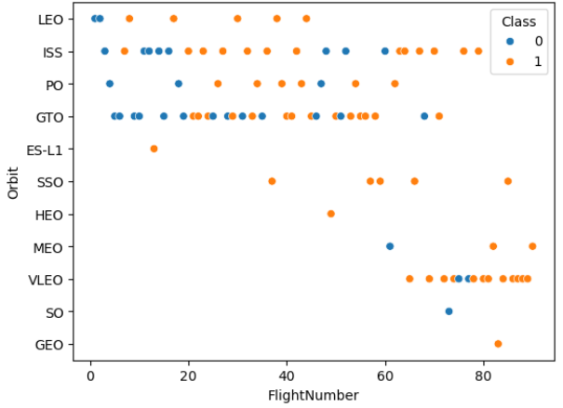
Flight Number vs. Orbit Type
Output
The plot shows the relationship between the orbit on the y-axis and the flight number on the x-axis.
The classes 1 and 0 represent successful and failed missions, respectively.

Slide 27
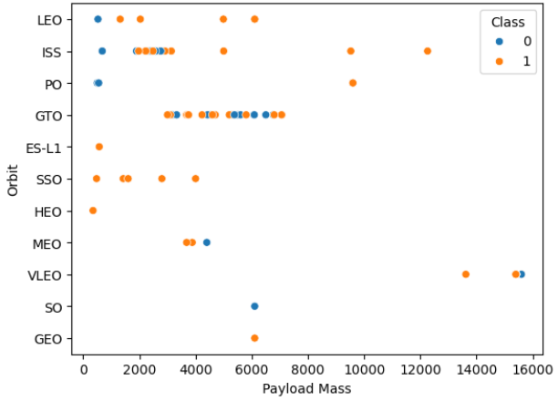
Payload vs. Orbit Type
Output
The plot shows the relationship between the orbit on the y-axis and the flight number on the x-axis.
The classes 1 and 0 represent successful and failed missions, respectively.

Slide 28
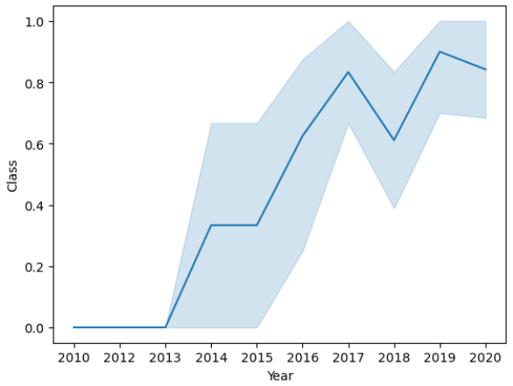
Launch Success Yearly Trend
Output
The plot shows the relationship between the orbit on the y-axis and the flight number on the x-axis.

Slide 29
EDA with sql

Slide 30
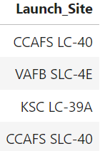
Launch Site Names
Query Task
Display the names of the unique launch sites in the space mission
SQL QUERY
%sql SELECT DISTINCT LAUNCH_SITE FROM SPACEXTABLE
Output
Shows that there are 4 launch sites and their names

Slide 31
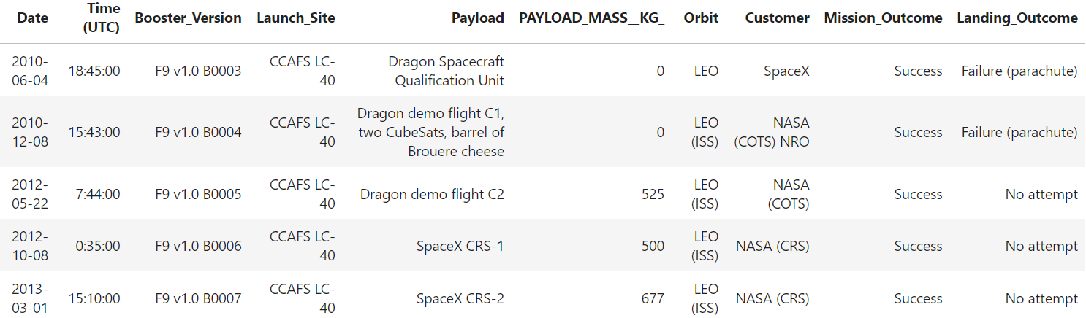
Launch Site Names Begin with 'CCA'
Query Task
Display 5 records where launch sites begin with the string ‘CCA’
SQL QUERY
%sql SELECT * FROM SPACEXTABLE WHERE launch_site LIKE 'CCA%' LIMIT 5
Output
Shows five records of launch sites whose names start with 'CCA,' including additional columns of information from the dataset related to each launch site

Slide 32
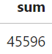
Total Payload Mass
Query Task
Display the total payload mass carried by boosters launched by NASA (CRS)
SQL QUERY
%sql SELECT SUM(payload_mass__kg_) as sum from SPACEXTABLE WHERE customer LIKE 'NASA (CRS)’
Output
Shows the sum (or total) payload mass carried by bossters launched by NASA (CRS)

Slide 33
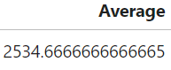
Payload Mass by F9 v1.1
Query Task
Display average payload mass carried by booster version F9 v1.1
SQL QUERY
%sql SELECT avg(payload_mass__kg_) as Average FROM SPACEXTABLE WHERE booster_version like 'F9 v1.1%’
Output
Shows the average of the paylaod mass carried by the bosster version F9 v1.1

Slide 34
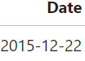
First Successful Ground Landing Date
Query Task
List the date when the first succesful landing outcome in ground pad was achieved
SQL QUERY
%sql SELECT MIN(date) as Date FROM SPACEXTABLE WHERE mission_outcome LIKE 'Success' AND landing_outcome LIKE 'Success (ground pad)'
Output
Shows the first successful landing outcome in ground pad date

Slide 35
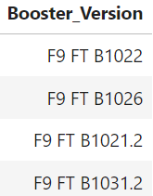
Successful Drone Ship Landing with Payload between 4000 and 6000
Query Task
List the names of the boosters which have success in drone ship and have payload mass greater than 4000 but less than 6000
SQL QUERY
%sql SELECT booster_version FROM SPACEXTABLE WHERE (mission_outcome LIKE 'Success') AND (payload_mass__kg_ > 4000 AND payload_mass__kg_ < 6000) AND (landing_outcome LIKE 'Success (drone ship)’)
Output
Shows the 4 boosters which have success in drone ship and have payload mass greater than 4000 but less than 6000

Slide 36
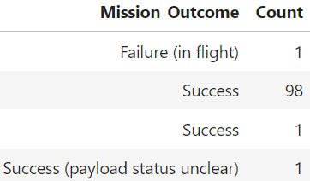
Total Number of Successful and Failed Mission Outcomes
Query Task
List the total number of successful and failure mission outcomes
SQL QUERY
%sql SELECT MIN(date) as Date FROM SPACEXTABLE WHERE mission_outcome LIKE 'Success' AND landing_outcome LIKE 'Success (ground pad)'
Output
Shows list of the counts of the mission outcomes

Slide 37
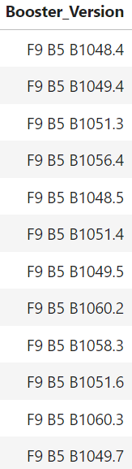
Boosters Carried Maximum Payload
Query Task
List the names of the booster_versions which have carried the maximum payload mass
SQL QUERY
%sql SELECT booster_version FROM SPACEXTABLE WHERE payload_mass__kg_ = (SELECT MAX(payload_mass__kg_) from SPACEXTABLE)
Output
Shows list of names of the booster_version which have carried the max payload mass

Slide 38
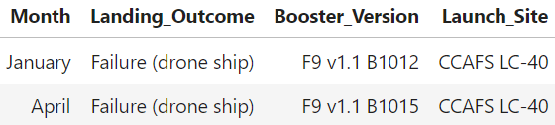
2015 Launch Records
Query Task
List the records which will display the month names, failure landing_outcomes in drone ship, booster versions, launch_site for the months in year 2015
SQL QUERY
%sql SELECT CASE WHEN substr(Date, 6, 2) = '01' THEN 'January' WHEN substr(Date, 6, 2) = '02' THEN 'February' WHEN substr(Date, 6, 2) = '03' THEN 'March' WHEN substr(Date, 6, 2) = '04' THEN 'April' WHEN substr(Date, 6, 2) = '05' THEN 'May' WHEN substr(Date, 6, 2) = '06' THEN 'June' WHEN substr(Date, 6, 2) = '07' THEN 'July' WHEN substr(Date, 6, 2) = '08' THEN 'August' WHEN substr(Date, 6, 2) = '09' THEN 'September' WHEN substr(Date, 6, 2) = '10' THEN 'October' WHEN substr(Date, 6, 2) = '11' THEN 'November' WHEN substr(Date, 6, 2) = '12' THEN 'December' ELSE 'Unknown' END AS Month, landing_outcome, booster_version, launch_site FROM SPACEXTABLE WHERE Date LIKE '2015%' AND landing_outcome LIKE 'Failure (drone ship)'
Output
Shows the Months of when the landing outcome is failure to Land in drone ship, booster versions, launch site for the months in year 2015

Slide 39
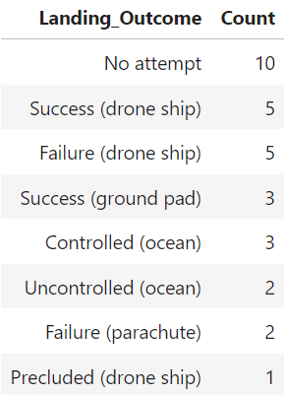
Rank Landing Outcomes Between 2010-06-04 and 2017-03-20
Query Task
Rank the count of landing outcomes (such as Failure (drone ship) or Success (ground pad)) between the date 2010-06-04 and 2017-03-20, in descending order
SQL QUERY
%sql SELECT landing_outcome, count(*) as Count FROM SPACEXTABLE WHERE Date >= '2010-06-04' AND Date <= '2017-03-20' GROUP by landing_outcome ORDER BY count DESC
Output
Show all landing outcomes along with the number of times each outcome occurred, sorted in descending order of occurrence

Slide 40

Launch Sites Proximities Analysis

Slide 41
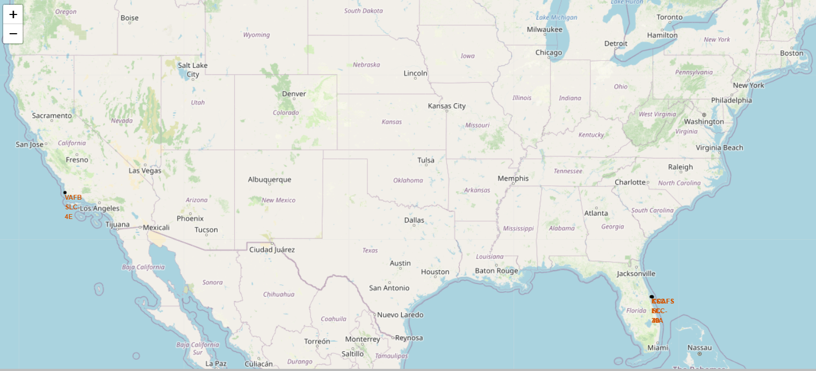
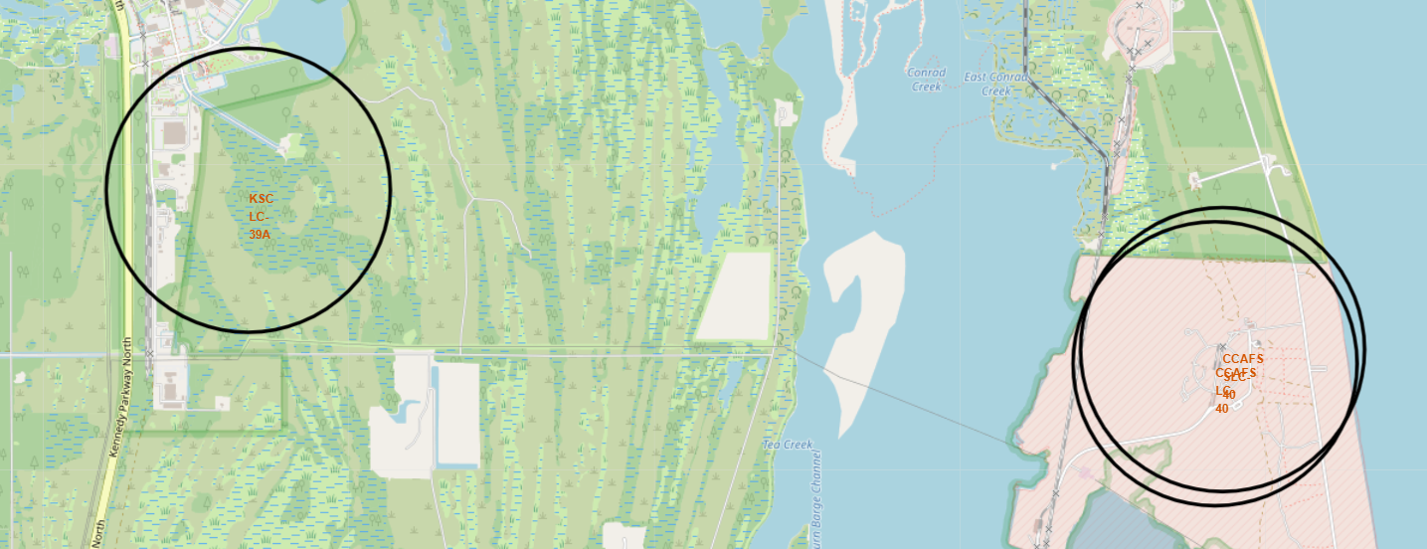
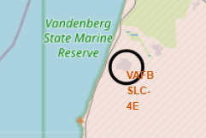
Mark all launch sites on a map
All Launch Sites Map
The 4 main rocket launch sites are loacted at:
CCAFS LC-40: Cape Canaveral, Florida
CCAFS SLC-40: Cape Canaveral, Florida,
KSC LC-39A: In Kennedy Space Center, Florida
VAFB SLC-4E: In Vandenberg Air Force Base, California
EDA Questions:
Proximity to Equator: Not all sites are directly on the Equator line.
Proximity to Coast: All sites are near the coast. CCAFS LC-40, CCAFS SLC-40 and KSC are on the east coast in Florida, and VAFB is on the west coast in California
Launch Sites in Florida
Launch Sites in California

Slide 42
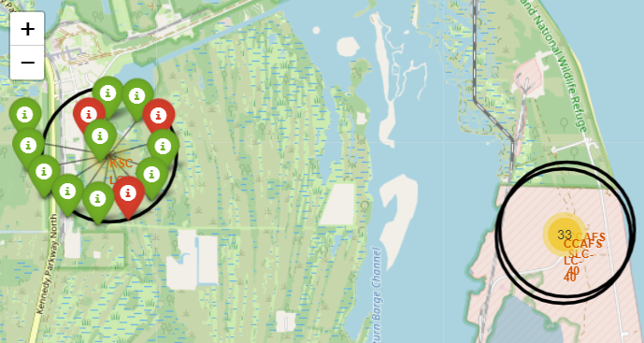
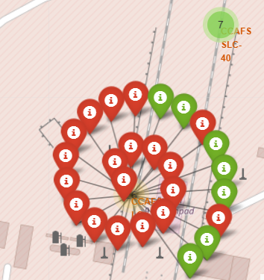
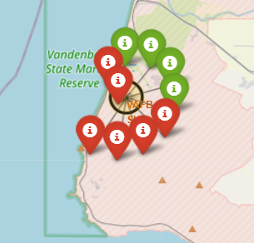
Mark Success/Failed Launches for Each Site
Launch Sites in Florida
The 4 main rocket launch sites are loacted at:
CCAFS LC-40: Cape Canaveral, Florida
CCAFS SLC-40: Cape Canaveral, Florida,
KSC LC-39A: In Kennedy Space Center, Florida
VAFB SLC-4E: In Vandenberg Air Force Base, California
Map Images:
The left image displays all launches at the four sites, with red indicating a failed launch and green indicating a successful launch
Hovering over each colored marker reveals the launch's name
Launch Site in Florida Example (KCS)
Launch Site in California (VAFB)

Slide 43
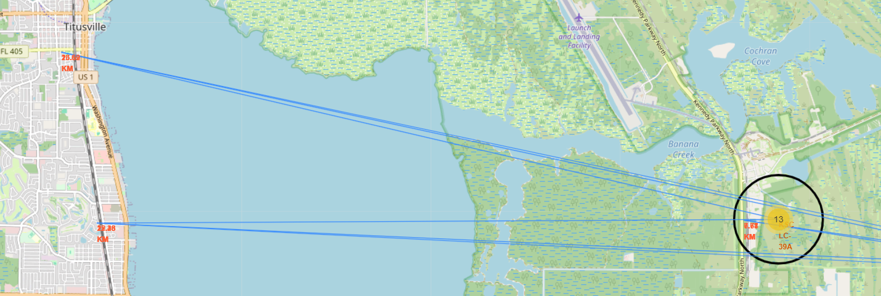
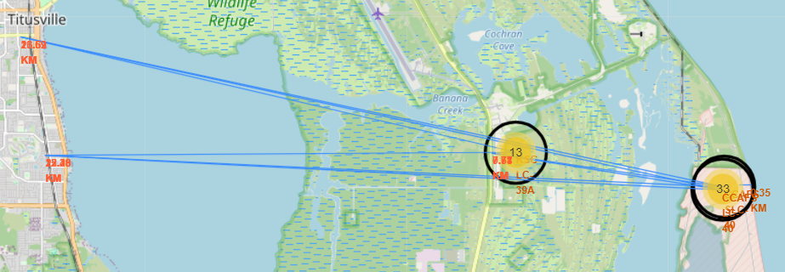
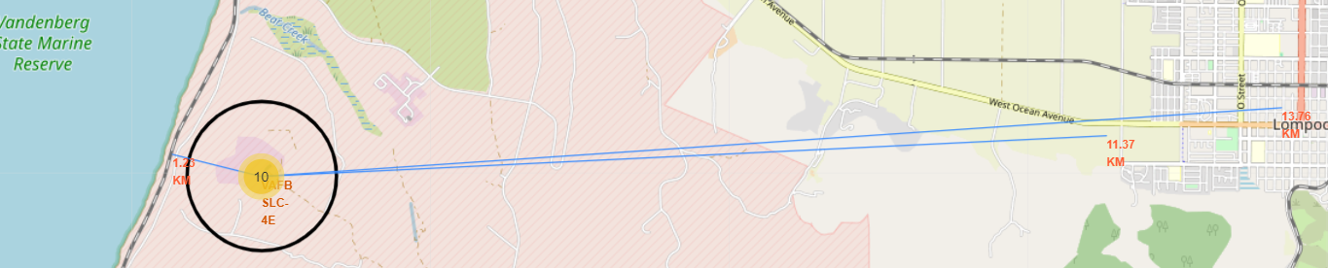
One of the launch sites in Florida is marked to the nearest railway, highway, and city/town.
distances between a launch site to its proximities
All three launch sites in Florida are marked to the nearest railway, highway, and city/town
The launch site in California is marked to the nearest railway, highway, and city/town.

Slide 44
distances between a launch site to its proximities (Cont.)
Questions:
1) Are launch sites close to the coastlines?
All sites are near the coast. CCAFS LC-40, CCAFS SLC-40 and KSC are on the east coast in Florida, and VAFB is on the west coast in California (Also answered on slide 41)
2) Are launch sites close to railways?
No, only the launch site in CA is close to a railway, with a distance of 1.33 km. All other Launch sites are around 20 to 30 miles away from railway
3) Are launch sites close to highways?
No, only the Florida launch sites are close to a highway, under 10 km
4) Do the launch sites keep a certain distance from cities/towns?
Yes, they do, and the range of this distance is 13 to 27 miles
Map Images (Slide 43):
The images on the earlier slide show all the distances from the nearest railways, highways, and cities/towns to each of the 4 main launch sites in CA and FL and display the distance in kilometers

Slide 45

Interactive Dashboard with plotly Dash

Slide 46
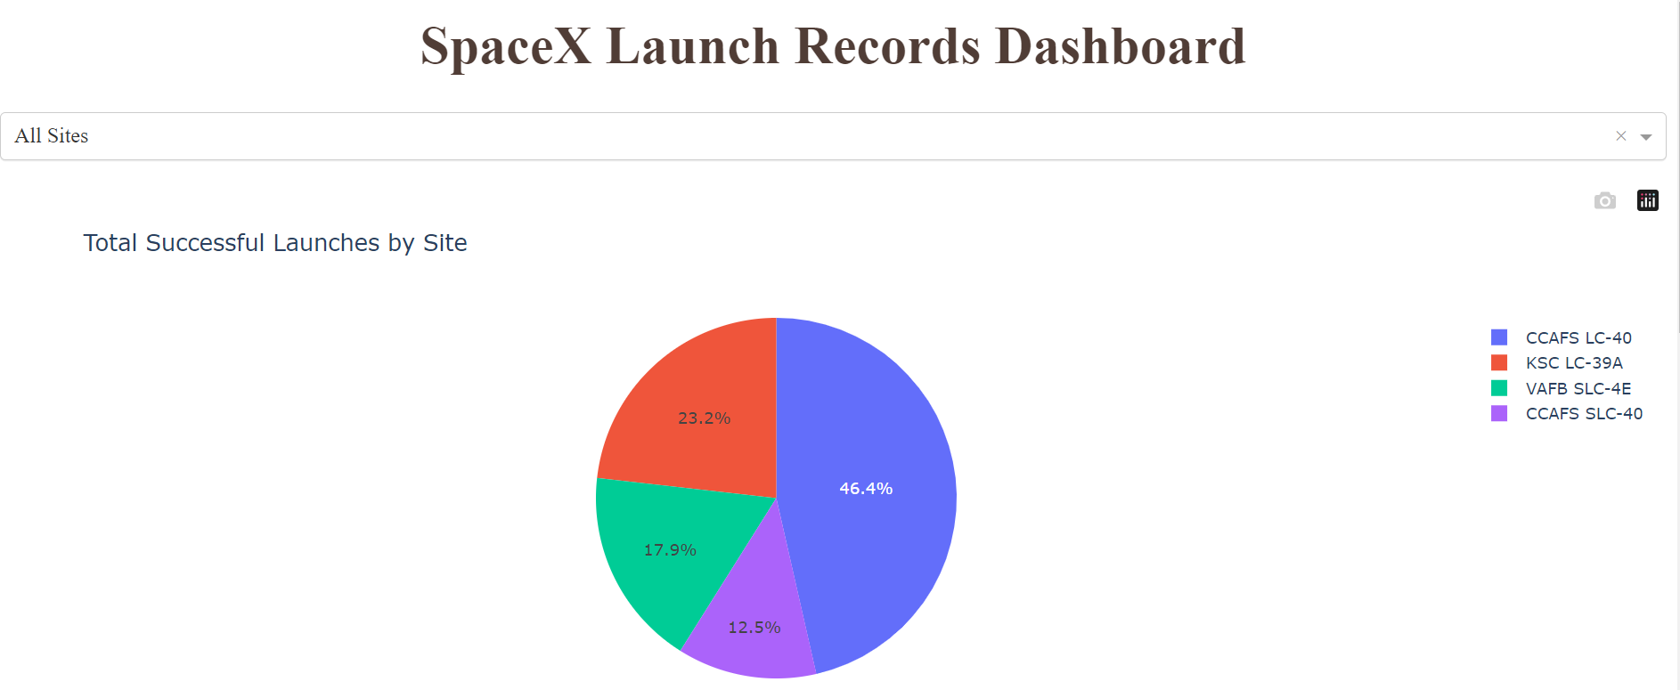
launch success count for all site
DashBoard compontents
A Dropdown menu of options to pick all the launch sites or certain ones to show their successful launches based on the selection, represented as a pie chart
Which site has the largest successful launches?
This question is to find the total count of successful launches per site
Answer: CCAFS LC-40 site has the largest number of successful launches

Slide 47
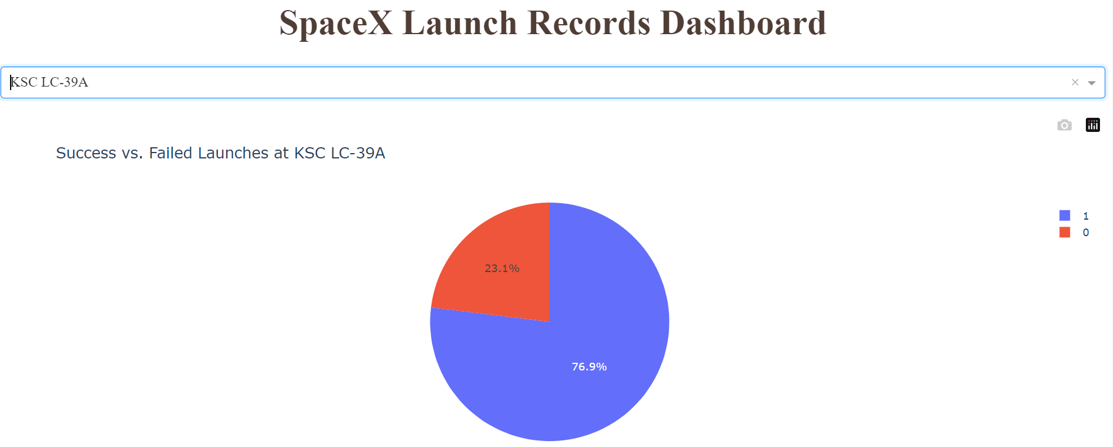
launch success With highest launch success ratio
DashBoard compontents
When selecting specific launch sites from the dropdown menu, the Pie Chart shows the percentage of successful vs. failed launches
Which site has the highest launch success rate?
This question looks at the ratio of successful launches to total launches for each Launch site
Answer: KSC LC-39A site has the highest launch success rate. With a Ratio of 76.9% (sucessful launches) to 23.1% (Failed Launchs)

Slide 48
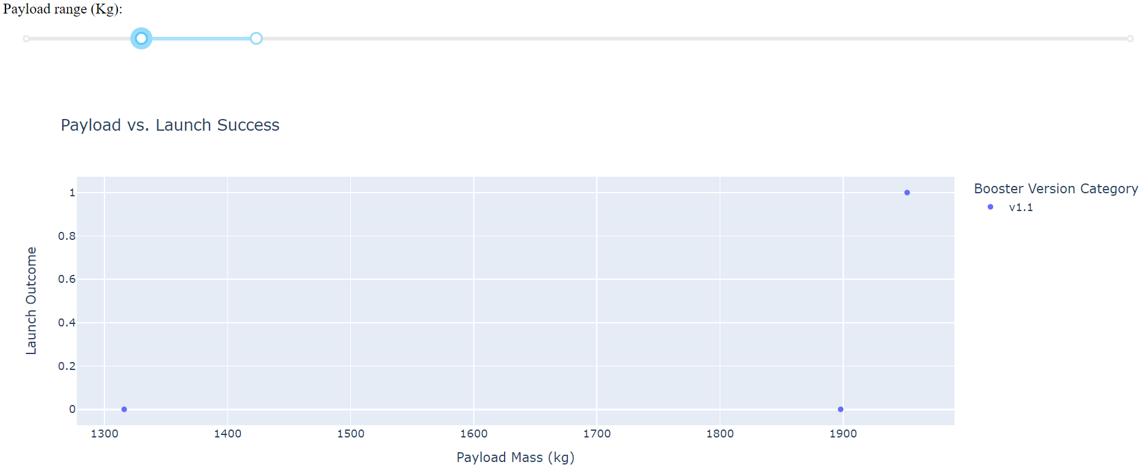
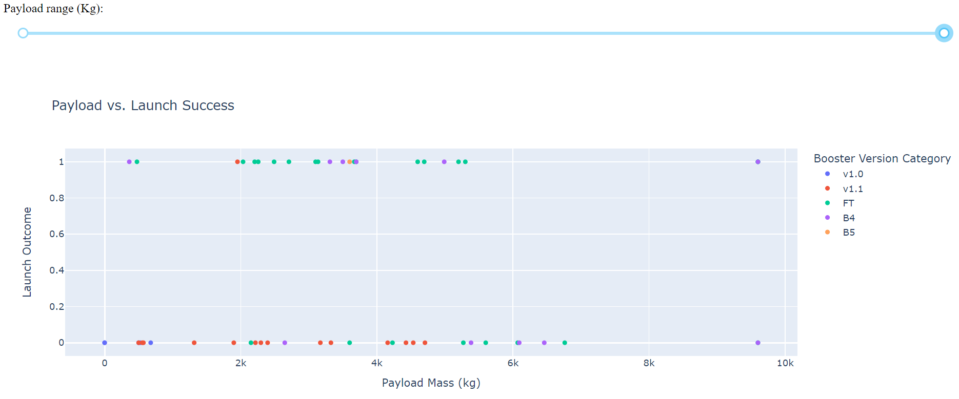
For Question 2
Payload vs. Launch Outcome scatter plot for all sites
Questions and Answers:
Which payload range has the highest launch success rate?
Answer: The range from 0kg to 10,000kg
21 sucessful launchs
Which payload range has the lowest launch success rate?
Answer: The range from 1,300kg to 1,900kg
1 Sucessful launch
Which Falcon 9 Booster version (v1.0, v1.1, FT, B4, and B5) has the highest launch success rate?
Answer: The Falcon 9 version FT
For Question 1

Slide 49

Predictive Analysis (Classification Algorithms)

Slide 50
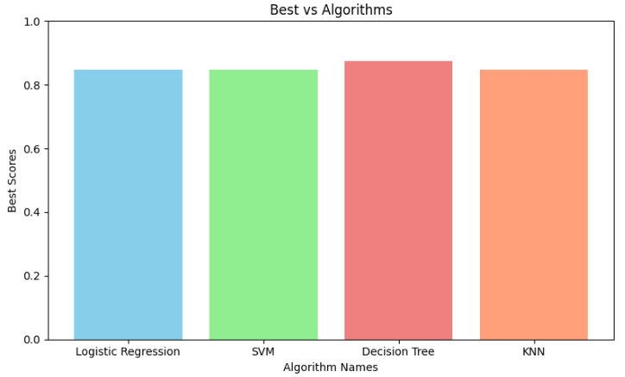
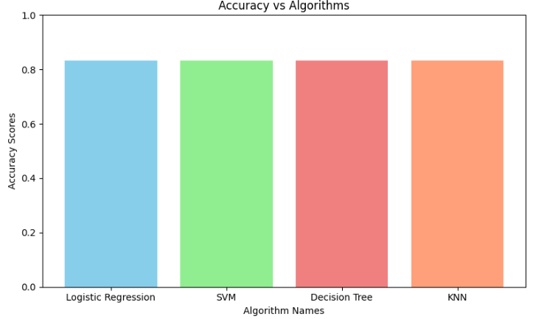
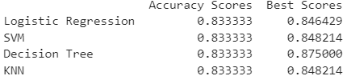
Classification Accuracy
Model with the Highest Classification Accuracy:
Decision Tree model has the highest Best Score
Best Score: 87.50%
Accuracy Score: 83.33%
Bar Charts:
Best Scores of All Algorithms
Accuracy Scores of All Algorithms

Slide 51
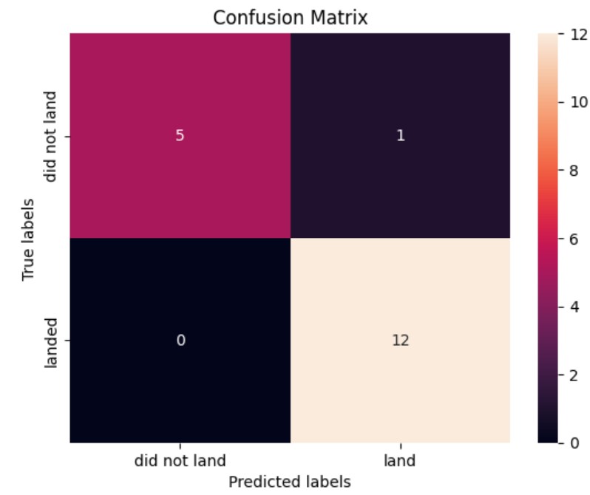
Confusion Matrix
Decision Tree Confusion Matrix Analysis
The confusion matrix represents a total of 18 results from the best classification algorithm.
The model performed well in predicting successful landings, 12 out of 18 correct predictions.
There were instances where the model incorrectly predicted a successful landing when it did not occur (1 out of 18).
The model's accuracy in predicting failed landings was 5 out of 18 correct predictions.

Slide 52

Conclusions
Figure 1
1) Over the years, there have been fewer failures in launches as the number of launches increased, especially after 2013, as depicted in Figure 1.
From 2010 to 2013, there were no successful launches. However, from 2017 onwards, the line graph reveals a trend where SpaceX has consistently achieved a high success rate.
2) The success of launches into different orbits shows the accuracy of rockets for each orbit, as illustrated in Figure 2.
The data illustrates that orbits such as ES-L1, GEO, HEO, and SSO all boast a perfect 100% accuracy for their rocket missions. This is because only one rocket has been sent to those orbit levels, except for SSO, as depicted in Figure 3. On the other hand, lower accuracy in orbits like VELO is expected, given its status as a low Orbit Level and the need for a higher payload due to gravity, as shown in Figure 4 (on next slide).
Occasionally, there are slight dips or increases, suggesting that they have reached the maximum limit of their accuracy in flights.
Figure 2
Figure 3

Slide 53
Conclusions
3) Most rockets are designed for higher orbit missions, resulting in lower payload mass requirements.
In Figure 4, we can observe that most launches have a payload range from over 0kg to 8000kg.
Figure 5 provides a clearer explanation of this trend by presenting the average payload (for booster version F9 v1.1), which is 2534.66kg. This indicates a generally low payload for the rockets.
Figure 4
Figure 5

Slide 54
Conclusions
4) Among the four main launch sites, the one in California has the highest success rate for launches, as depicted in Figure 6.
The ratio of successful to failed launches at the KSC LC39A CA launch site is 76.9% to 23.1%.
5) The best classification algorithm for this dataset is Decision Tree.
Figure 7 displays the confusion matrix of the best classification algorithm for determining if a launch will be successful or not.
Figure 6
Figure 7

Slide 55

Appendix

Slide 56
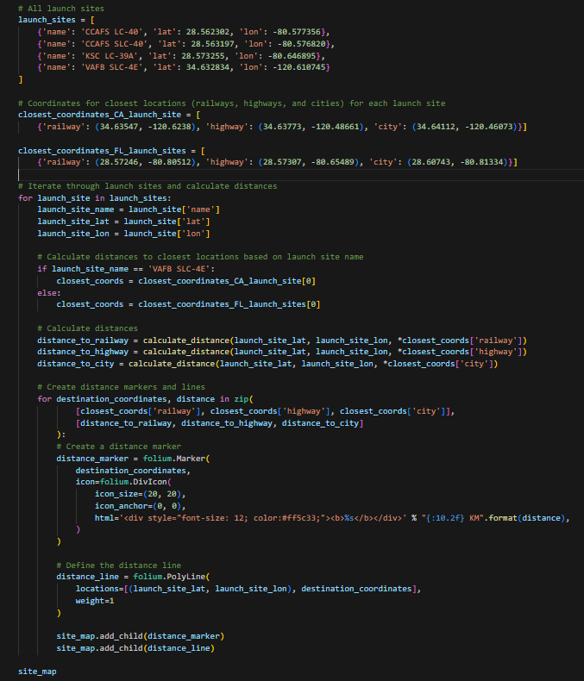
Custom Logic for Folium Map

Slide 57
Thank YOU ☺

